Slide 1
FYP5: Object Detection, Tracking and Suspicious Activity Recognition for Maritime Surveillance using Thermal Vision

Slide 2
Weekly Tasks
Conversion of MATLAB scripts to Python to load frame-by-frame and generate action tubes
Creating the pipeline for ROAD

Slide 3
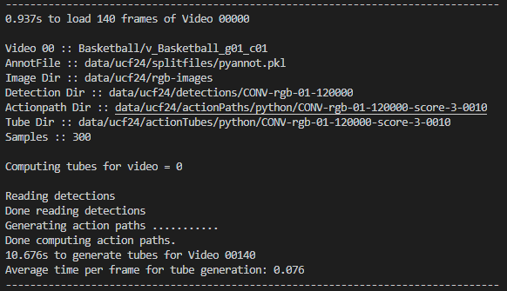
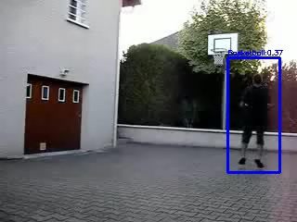
Results after the conversion of MatLab to Python
Avg. time to load a frame | 7ms
Total time to generate tubes per video with 140 frames (24 actions) | 10.7s
Time to incrementally link a tube to next frame (24 actions) | 76ms

Slide 4
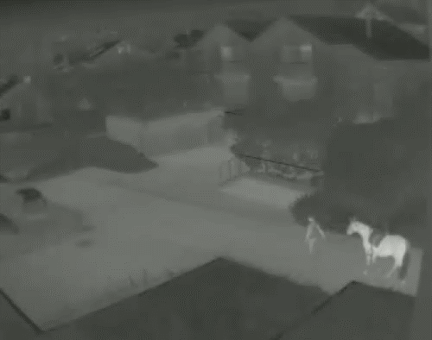
Object tracking in Thermal Environment
KCF Tracker
Median Flow Tracker
CSRT Tracker
MOSSE Tracker

Slide 5
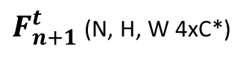
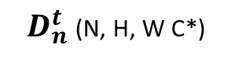
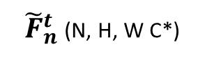
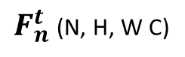
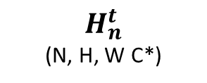
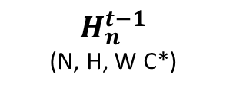
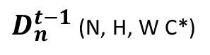
$F_{n}^{t}$ (N, H, W C)
1x1 2D Conv
1x1 2D Conv
1x1 2D Conv
$D_{n}^{t−1}$ (N, H, W C*)
$D_{n}^{t}$ (N, H, W C*)
3x3 2D Conv
3x3 ConvLSTM
3x3 2D Conv
-
$H_{n}^{t−1}$
(N, H, W C*)
$H_{n}^{t}$
(N, H, W C*)
Spatio-Temporal Block Design
${\tilde{F}}_{n}^{t}$ (N, H, W C*)
1x1 2D Conv
1x1 2D Conv
1x1 2D Conv
+
$F_{n+1}^{t}$ (N, H, W 4xC*)

Slide 6

Tasks for next week
Work on the integration of CenterNet with ROAD
Creating the pipeline for ROAD

